Slide 2
Flight Controller for Autonomous Drones
Student: Supervisor(s):
Marcus Christiansen Søren Hansen
Nils Axel Andersen

Slide 3
Mission
Notes:
Limitations The limitations of the project can be summarized into the following points: 1. All testing has to be done indoors due to Danish drone regulations and safety. 2. The project builds on top of an existing project, which limits the project. For instance in regards to hardware. The software has to be able to run on a Raspberry Pi. 3. The time frame of the project is approximately 5 months

Slide 4
Objectives
Simulate a Hexacopter in Simulink.
Use the simulation to design a positional controller for X, Y, Z, and Yaw.
Implement controllers on a real-time system.
Implement a global positioning System.
Implement an accurate positioning system for precision tasks.
Notes:
Limitations The limitations of the project can be summarized into the following points: 1. All testing has to be done indoors due to Danish drone regulations and safety. 2. The project builds on top of an existing project, which limits the project. For instance in regards to hardware. The software has to be able to run on a Raspberry Pi. 3. The time frame of the project is approximately 5 months

Slide 5
Outline
Simulation
Derive equations required for simulation
Controller Design
How the controllers were designed
Implementation
Implementation of controllers and tracking system
Results
Overall evaluation of the performance of the different systems

Slide 6
Simulation

Slide 7
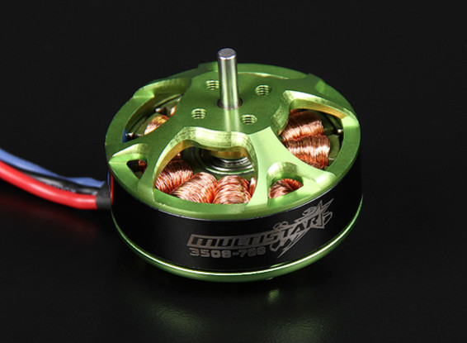
Simulation - Motor
Type:
MultiStar 700KV
BLDC
14.8 volt rating
0.134 Ohm
Goal:
Get relation between PWM and angular velocity
Notes:
KV 700 = 10360 RPM
Batt 14.8 volt (4s)
0.083 ohm in matlab (Probably wrong)

Slide 8
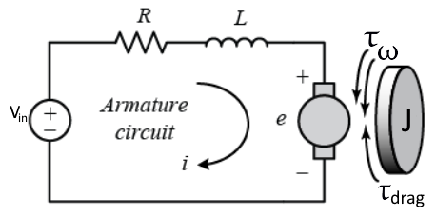
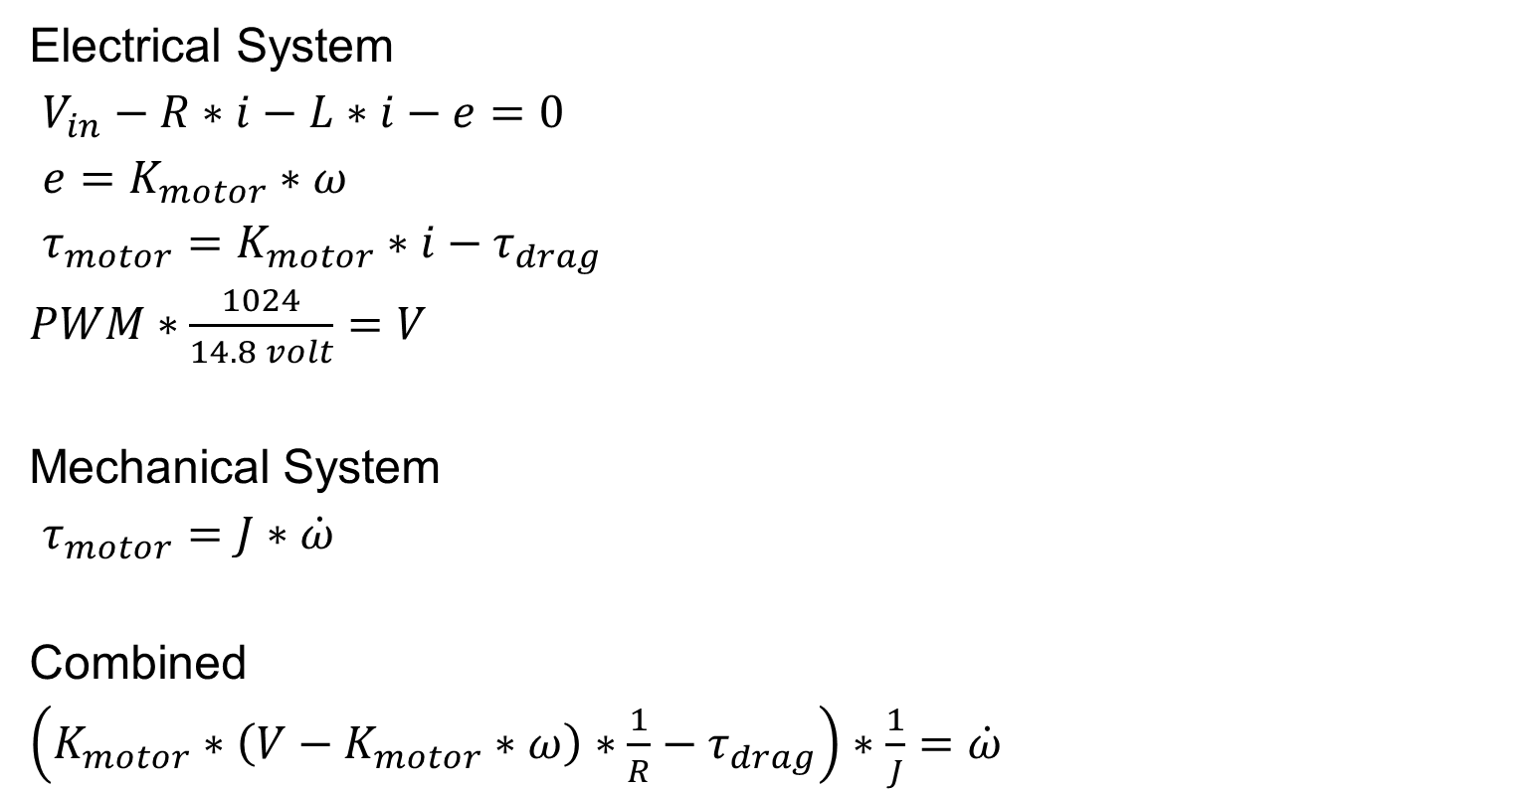
Simulation - Motor
Electrical System
$V_{in}−R∗i−L∗i−e=0$
$e=K_{motor}∗ω$
$τ_{motor}=K_{motor}∗i−τ_{drag}$
$PWM∗\frac{1024}{14.8 volt}=V$
Mechanical System
$τ_{motor}=J∗\dot{ω}$
Combined
$\left(K_{motor}∗\left(V−K_{motor}∗ω\right)∗\frac{1}{R}−τ_{drag}\right)∗\frac{1}{J}=\dot{ω}$
Notes:
Kirchofs law. Sum of all voltage in a closed loop is 0.
T_drag is the props giving resistance
Inductance is ignored
In analyzing the motor, we can usually ignore the inductance since the L/R electrical time constant is much shorter than the mechanical time constant determined by the rotor's moment of inertia

Slide 9
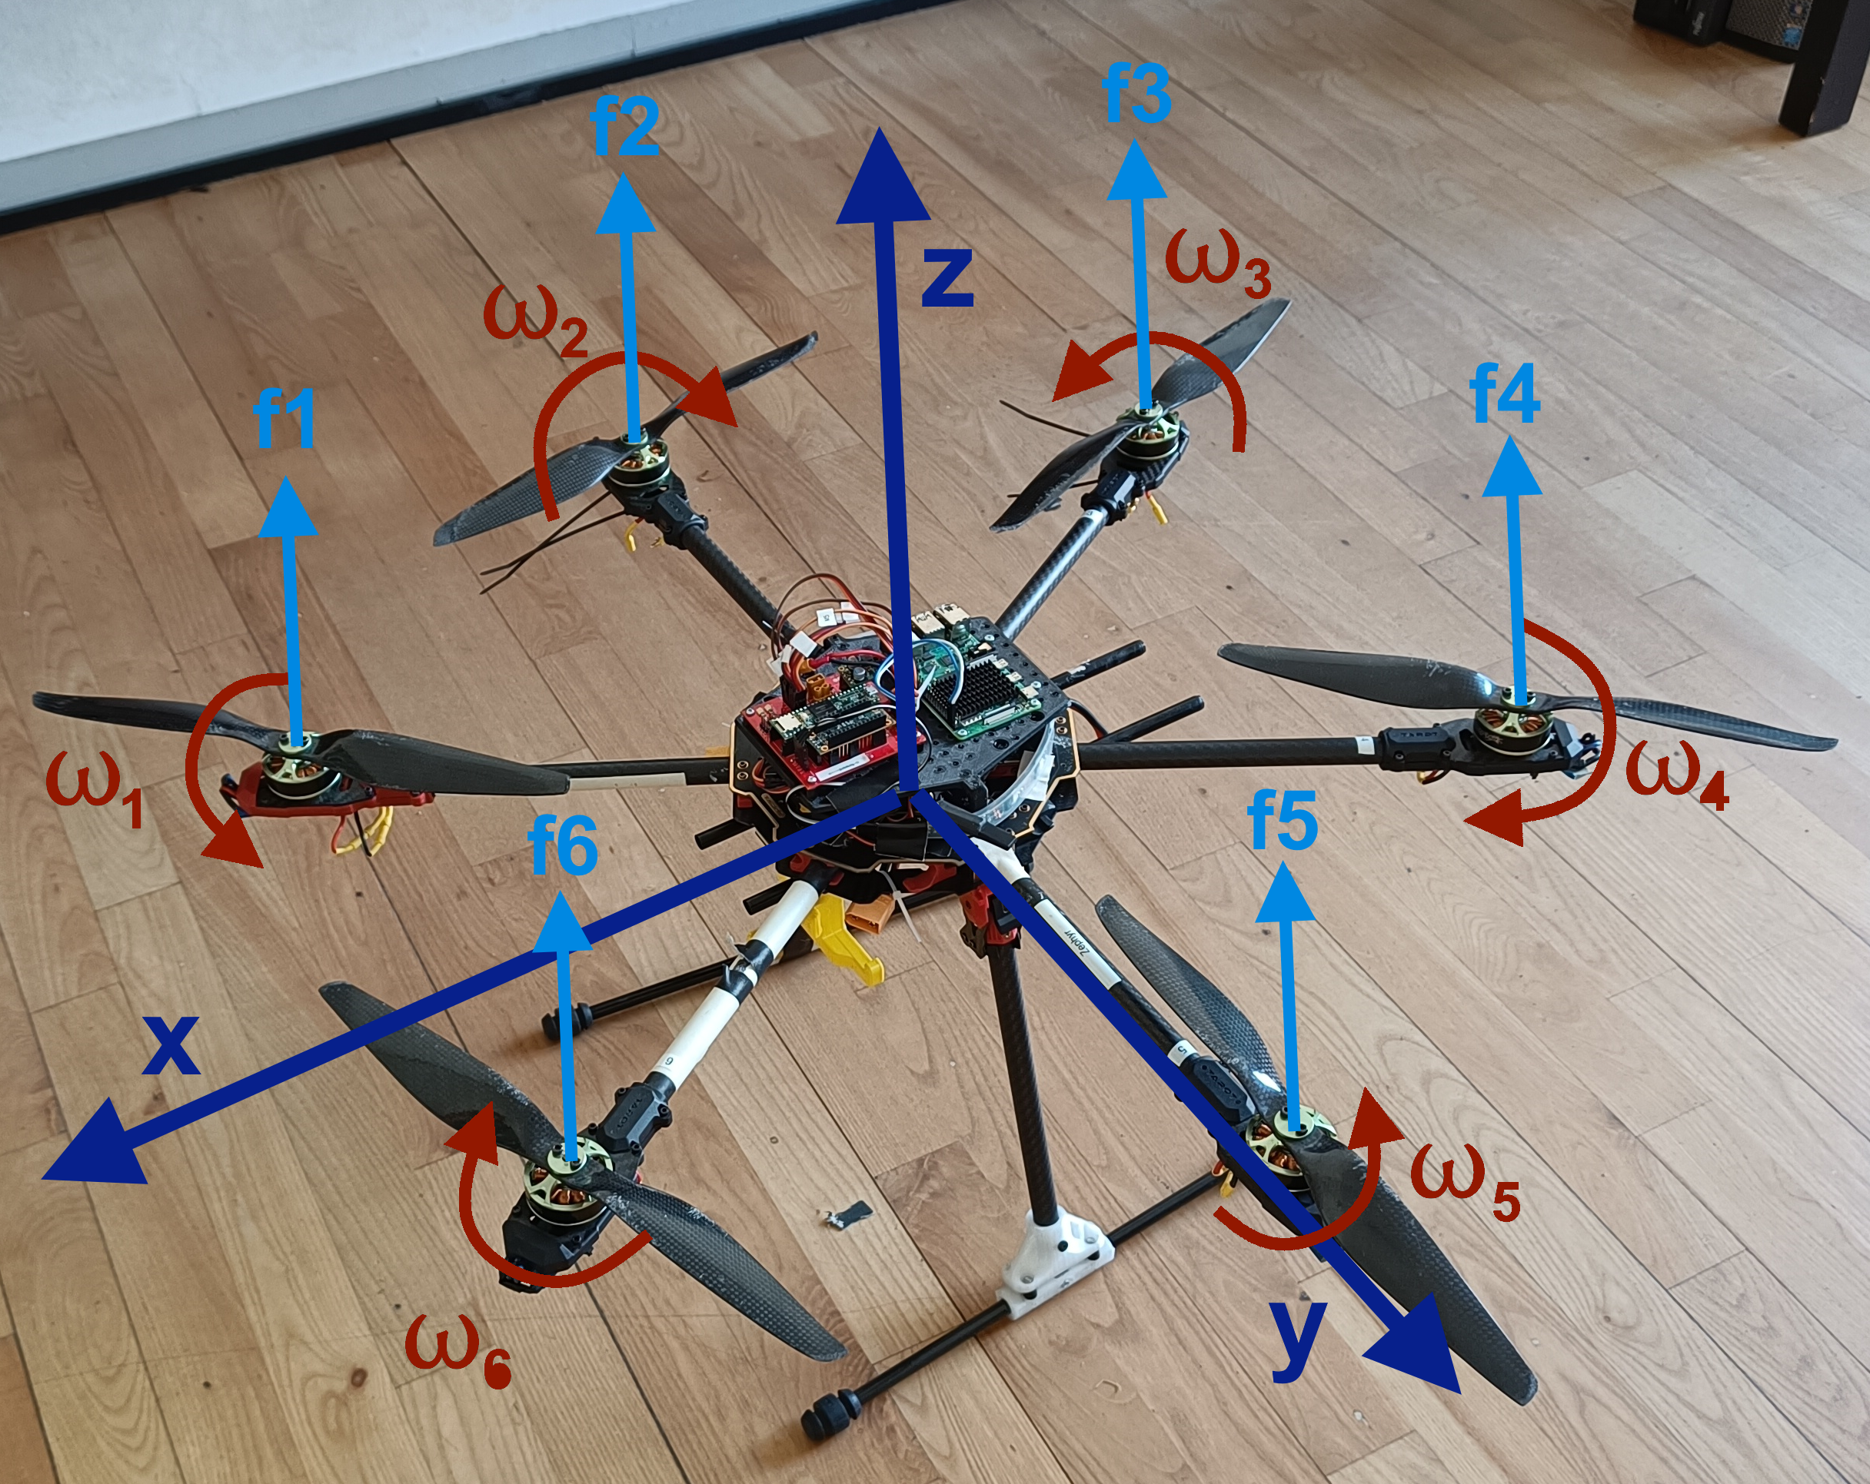
Simulation – Forces
Linear
Propeller force
Gravity
Air viscosity
Rotational
Motor torque
Thrust vector offset from center of mass
Notes:
Air viscosity. Only important for position control
Has 6 DOF, but can only apply a force in its own relative z direction

Slide 10
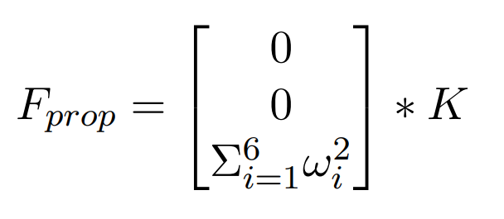
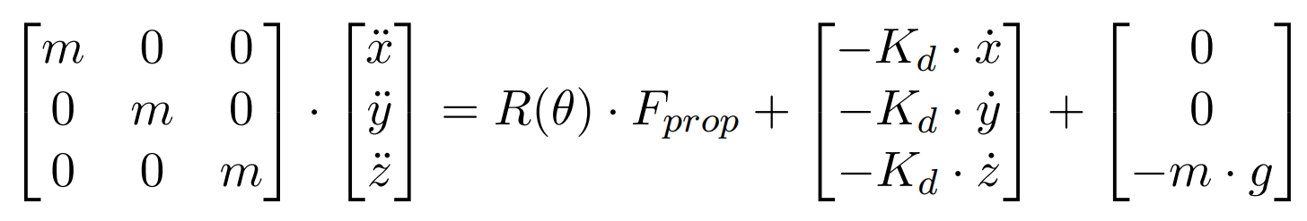
Simulation – Forces
Linear Dynamics
Notes:
Kd - Air viscosity. Only important for position control
K is constant describing relation between angular velocity and the lift generated

Slide 11



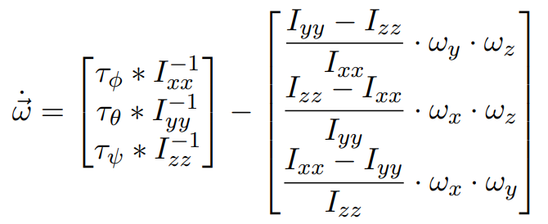
Simulation – Forces
Rotational Dynamics
Notes:
L_x and L_y describes point of lift.
B is drag coefficient for propellers
I_xx I_yy should be the same. I_zz is not
Drone can be decribed as a disc when talking inertia.
Final equation is angular acceleration around x y and z.
Last equation gives angular acceleration for x y and z.

Slide 12
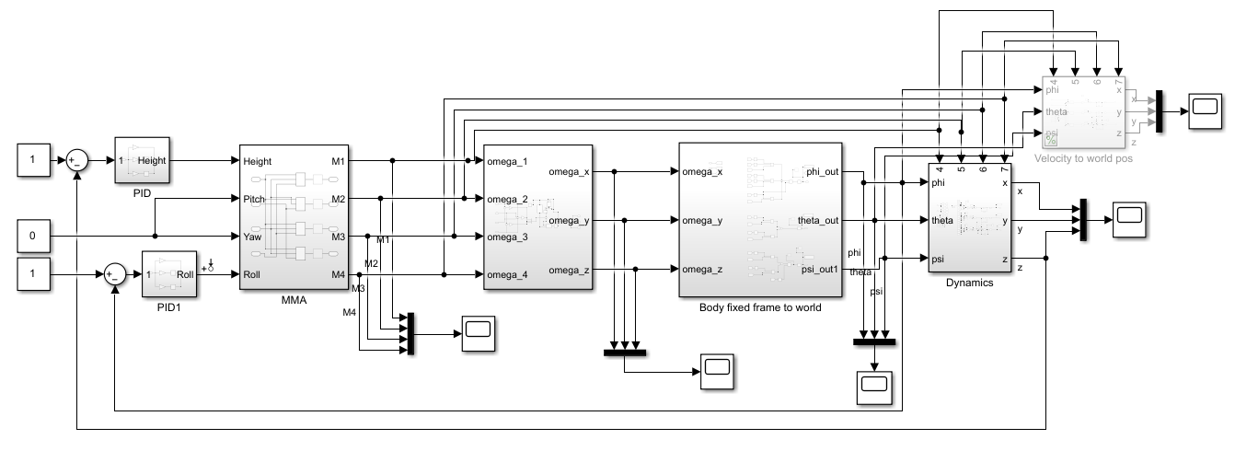
Simulation - Model

Slide 13
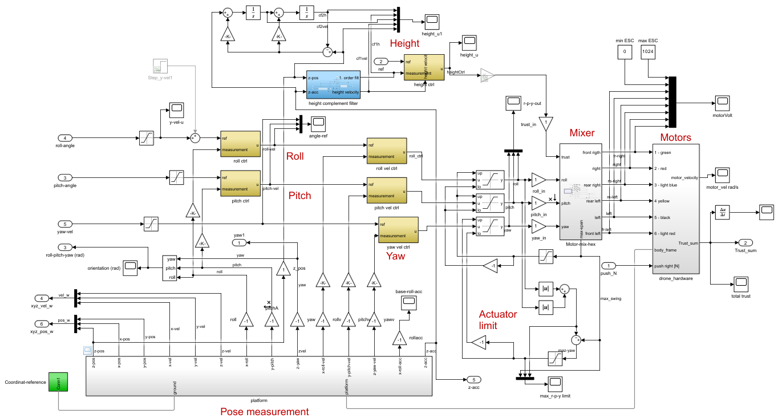
Simulation - Model

Slide 14
Simulation

Slide 15
Simulation - Model

Slide 16
Simulation - Discretization
Biliniear transform

Slide 17
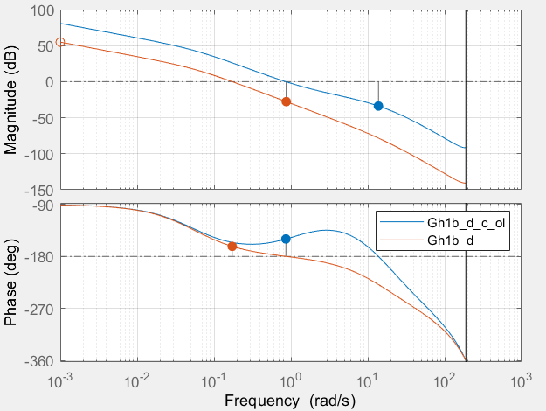
Simulation – Height Controller
Height Controller criterias
Plead
Easier to tune than PILead
Lead required due to 180 phase shift
Low kp gain
Less agressive reponse
Fairly high phase and gain margin
60 hz update rate
Notes:
Phase margin could be better but that gives a higher KP which leads to a more aggressive system (Not wanted for testing)
This is for height
High phase and gain because model does not fit reality

Slide 18
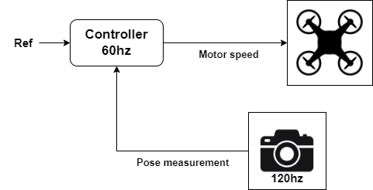
Simulation - Height Controller

Slide 19
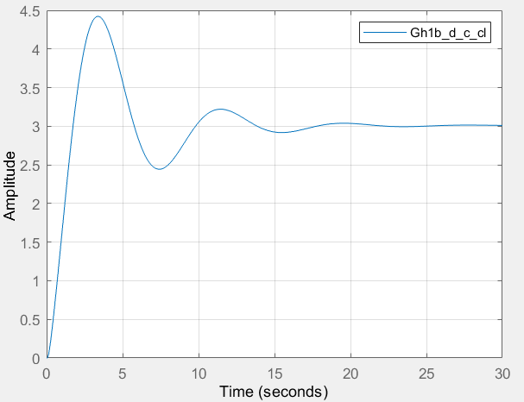
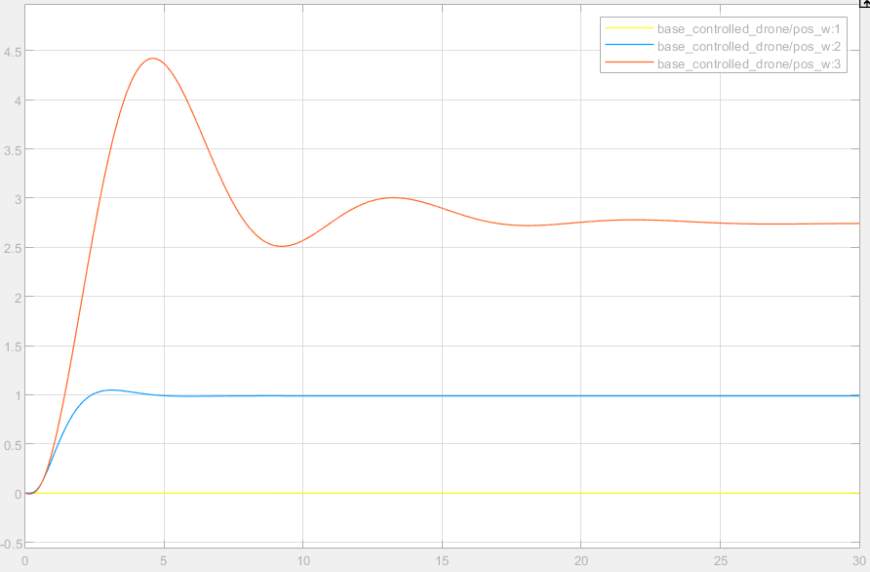
Simulation – Step response
Matlab TF step Simulink
Notes:
Left matlab step
Right simulink
Simulink is lower due to the assumption in left side that hover thrust is known.
Can be fixed by an I term

Slide 20
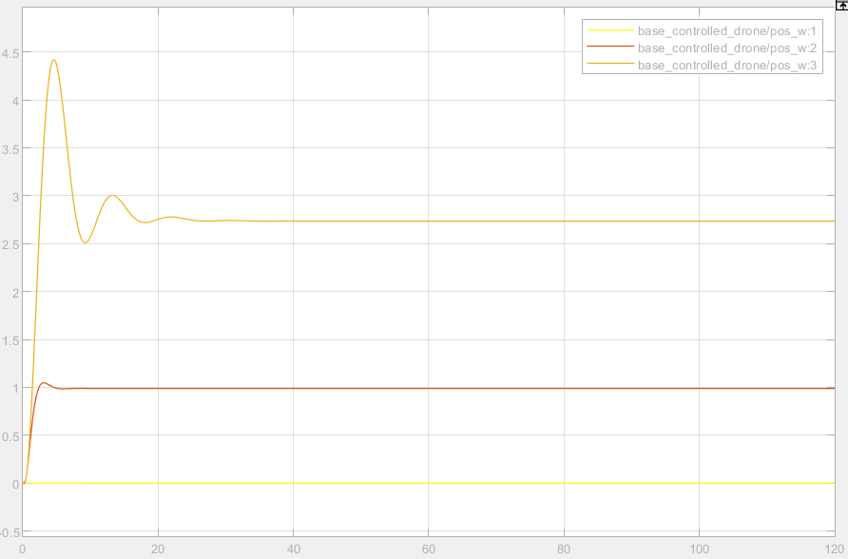
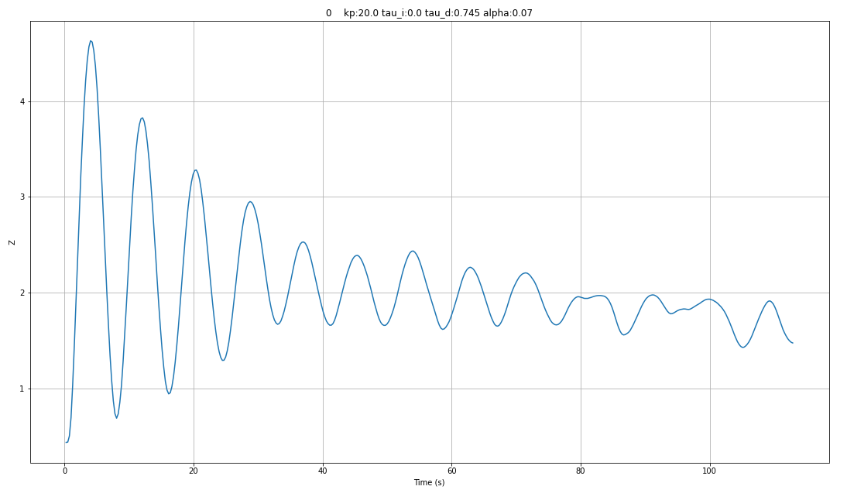
Real System
Simulation Real system

Slide 21
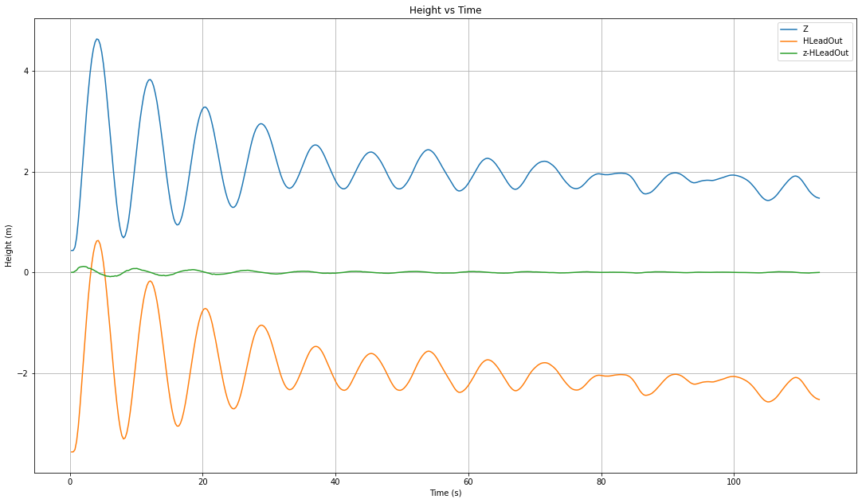
Real System

Slide 22
